Slide 1
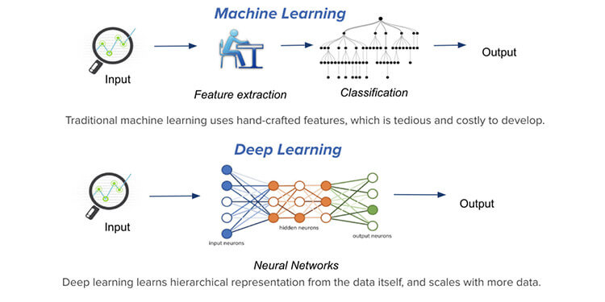

Slide 2
chat GPT
Generative Pre-trained Transformer
In a nutshell, Chat GPT is an
artificial intelligence (AI) content generator
that semi-autonomously creates phrases and articles
based on user input.

Slide 3
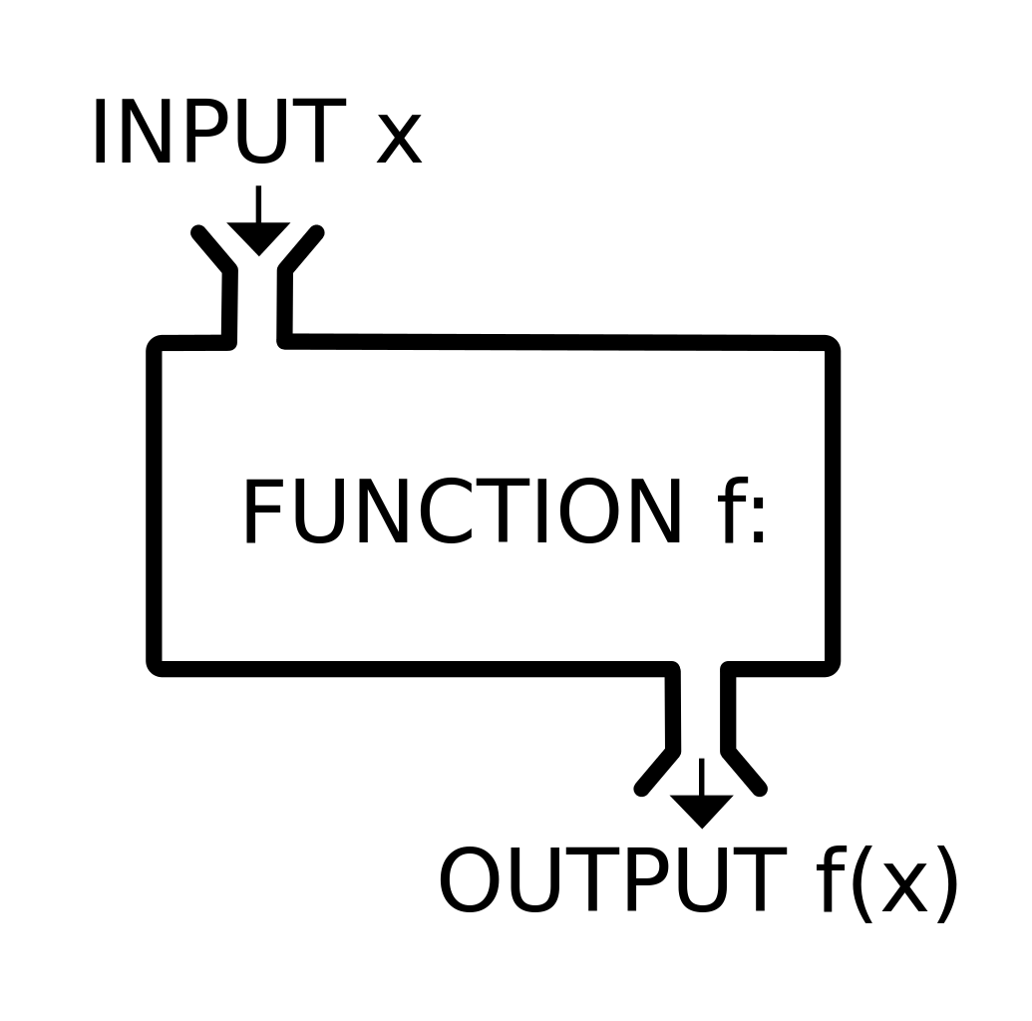
Function

Slide 4
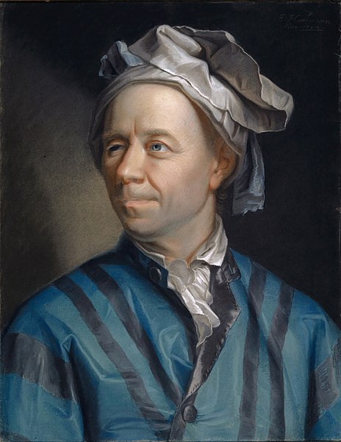
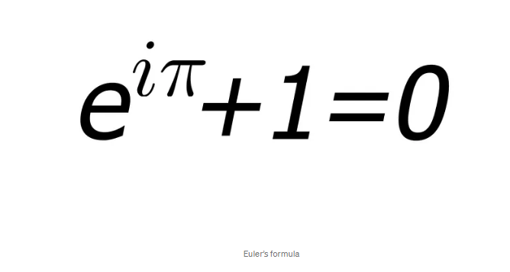
Leonhard Euler Introductio in Analysin Infinitorum. 1748

Slide 5
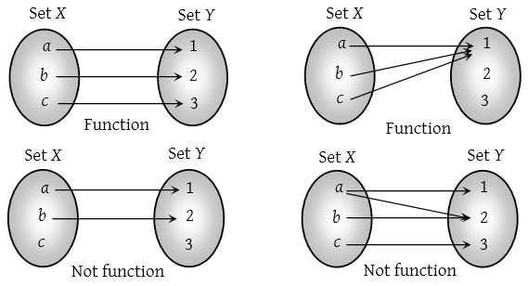
function

Slide 6
Function

Slide 7


Slide 8
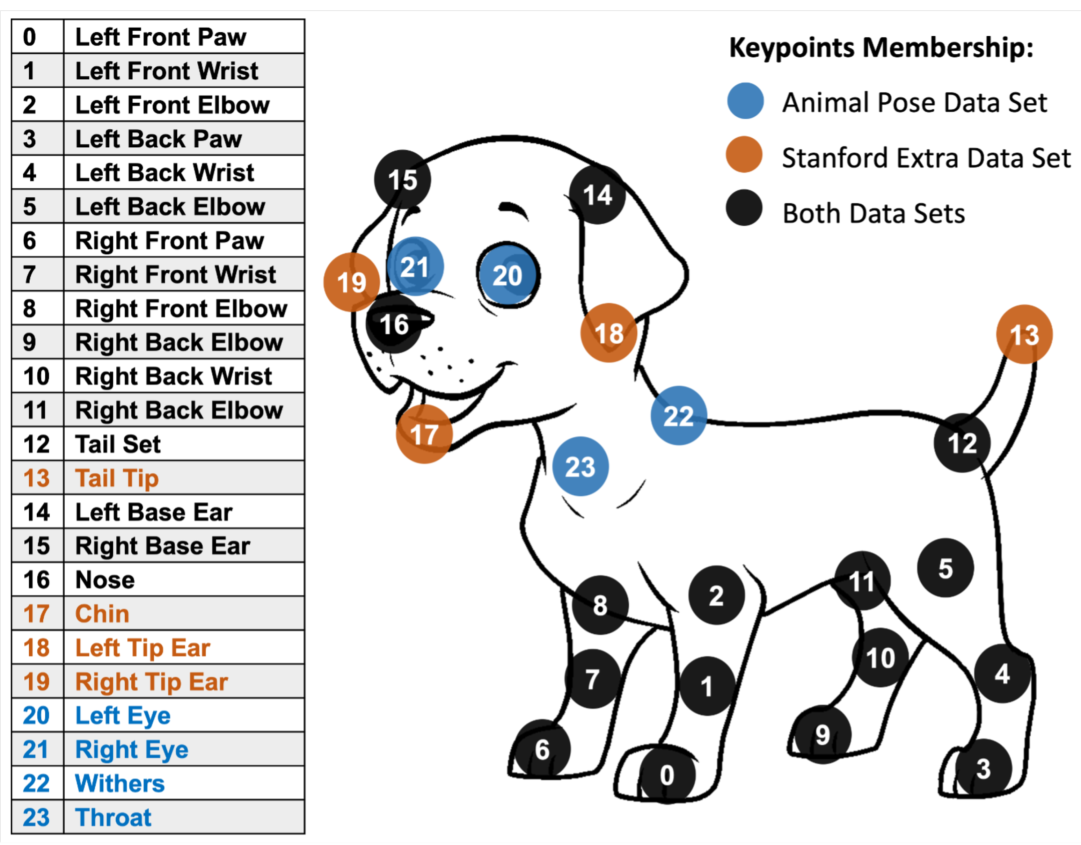

Slide 9
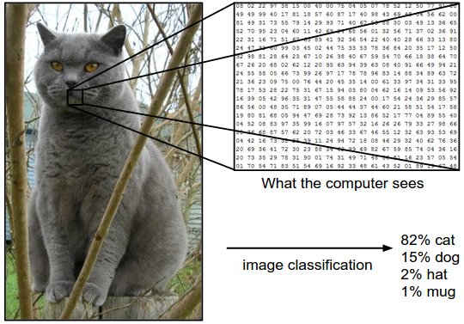

Slide 11
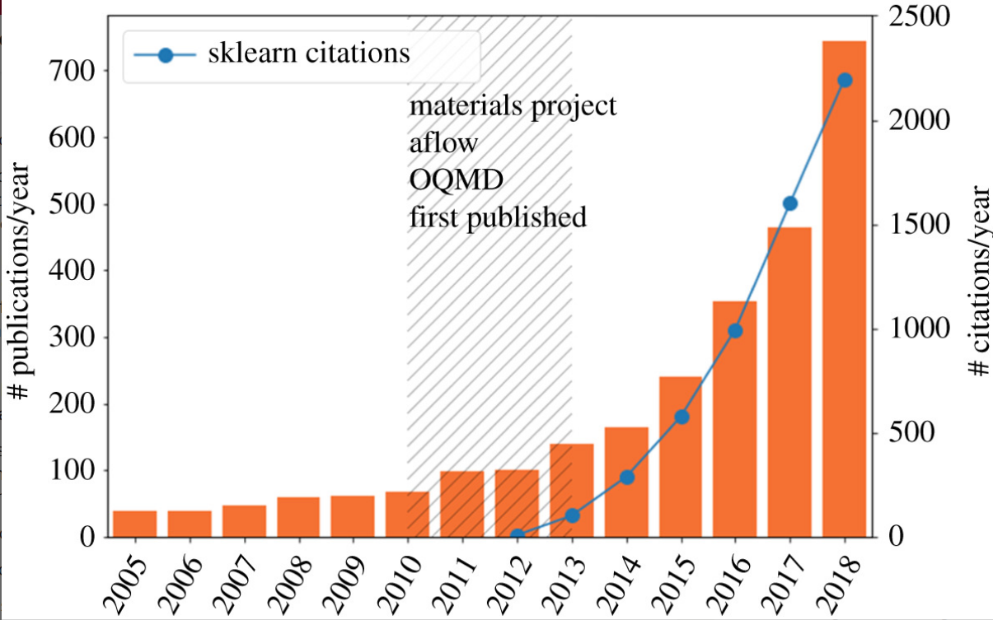
The ML explosion in materials science. The number of papers containing the terms machine learning
Machine learning and big scientific data Tony Hey , Keith Butler , Sam Jackson and Jeyarajan Thiyagalingam Published:20 January 2020

Slide 12
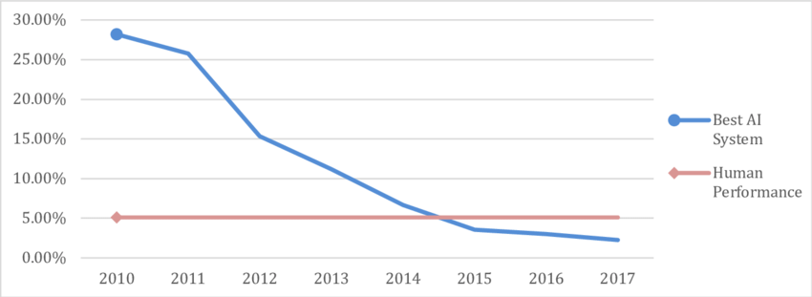
Error rate in the ImageNet Large Scale Visual Recognition Challenge. Data for AI performance from Shoham et al. (2018, p. 90), for human performance from Russakovsky et al. (2015, pp. 241&242).

Slide 13
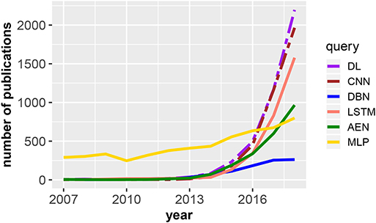
Number of publications in dependence on the publication year for DL, deep learning;
Frontiers | An Introductory Review of Deep Learning for Prediction Models With Big Data (frontiersin.org)

Slide 15
Function

